Slide 1

A.C.M.E.:
Automated Collection and Manipulation of Email
Ryan Peters
Faculty Advisor: Prof. Bill Erdly
Sponsor: Dr. Luke Marney
Notes:
Get one of those loony tunes acme rocket or dynomyte images for title slide background.

Slide 2
Introduction: Motivation
“Email management consumes significant effort from senders and recipients. Some of this work might be automatable.” - (Park, Zhang, Murray, and Karger. 2019)
“It is estimated that 269 billion emails were sent…per day in 2017 [26] …workers tend to spend up to 28% of their time reading and answering email…” - (Sarrafzadeh, Awadallah, Lin, Lee, Shokouhi, and Dumais. 2019)
The core principle of maintaining a strong professional, and collaborative, network is being able to emphasize the human connection elements in each interaction.
For full citations see slide titled ‘Citations’ at the end of presentation.
Notes:
The proverbial days of the lone mad hermit learning the secrets of transmuting stone into gold are gone. All society impacting work going forward will be done by ever larger and more complex teams experts and specialists. This implicitly demands that the volumes of communication and exchange of information must also increase.
However, there is most certainly a breaking point, or a threshold where things break down, and it’s not going to be the same for every individual.

Slide 3
Introduction: Stakeholder Specifications
The project was designed with the following specifications in mind:
Must be 100% open source.
No key dependencies on third-party libraries that use closed source code.
This ensures access to community driven solutions, and independent control over the project’s capability to adhere to possibly unique security requirements.
Ensures secured access to proprietary data in lab settings with limited-to-zero external network access.
Must be modular, with a linear execution sequence through project sub-modules.
Ensures easy modification to program flow and hot-swapping of alternate modules.
Acceptable loss of potential performance optimizations on per-email parallel pipelining.
Should provide a minimal viable CLI
Leave complex, or specialized, interfaces for later development by user community.
Notes:
This project does not directly employ specific security tools outside of the use of password protected databases for data caching.
Ensures secured access to proprietary data in lab settings with limited-to-zero external network access.
Get project code to your desired operational state, clone it to your thumb drive and set up your private network,
complete with custom internal mail server, and run your custom data extraction/analysis/classification tools in that setting.
The project’s sponsor and primary stakeholder, Dr. Luke Marney,

Slide 4


Help people invest their time and energy into new ideas and stronger human connections by separating and opening the computational tools to analyze their inbox.
Introduction: End Goal
Go from this:
To this:
Photo from:
https://www.craftyourcontent.com/wp-content/uploads/2017/05/The-Future-of-Writing-With-Robots-1024x379.png
Photo from:
https://www.shutterstock.com/image-photo/close-african-business-man-hands-working-1460065946
Notes:
Humans be Human: As the volume of emails demanding
An often-overlooked key to effective collaboration and successful industry networking is to maintain focus on the human element of an interaction.
No one can be an expert at everything.
necessity is the mother of innovation
Processing the objective purpose of communications at the pace of modern work life is a non-trivial task.
You must assess not only what people are asking of you, but if you can even provide what they seek.
you must make sure you don’t overlook any corollary requests and secondary details.
it can often result in people losing sight of the human purpose of the interaction.
Collaboration
Relief from problems outside of their skill domain
Simple guidance/insight
Etc.

Slide 5
Help people invest their time and energy into new ideas and stronger human connections by separating and opening the computational tools to analyze their inbox.
Introduction: End Goal
Let Humans be Human:
Give people the tools needed to reduce time spent extracting details from their email, so more time can be spent focusing on the interaction with the person at the other end of the message.
Notes:
Humans be Human: As the volume of emails demanding
An often-overlooked key to effective collaboration and successful industry networking is to maintain focus on the human element of an interaction.
No one can be an expert at everything.
necessity is the mother of innovation
Processing the objective purpose of communications at the pace of modern work life is a non-trivial task.
You must assess not only what people are asking of you, but if you can even provide what they seek.
you must make sure you don’t overlook any corollary requests and secondary details.
it can often result in people losing sight of the human purpose of the interaction.
Collaboration
Relief from problems outside of their skill domain
Simple guidance/insight
Etc.

Slide 6
Methods
Ok, but how? Core Design Philosophy. Tools & Technologies. Project Component Breakdown What ARE Tasks?

Slide 7
Methods: Ok, but how?
TL;DR:
Abstract away the more nuanced technical details surrounding programmatic access to, and processing of, statistical/structural information encoded in your own email!
We built code base that allows those with a non-CS background to easily:
Collect email messages from an imap mail server
Convert those messages into raw text strings with various degrees of meta-data attached
Extract some initial statistical data from the exposed raw text.
Notes:
Help people break away from having to invest hours of their day trying to leverage past accomplishments, freeing them to put their time and energy into new ideas, stronger connections, or simply that all too neglected “me” time.
Be fluid, adaptive, modular:
There are many steps along the path to being able to perform statistical and structural analysis on the emails in your inbox. Not all the steps for person A may be necessary for person B, so we built each discrete step as a stand-alone module with well defined input/output specifications.

Slide 8
Methods: Core Design Philosophy
Be fluid, be adaptive, be modular
Provide complete access to source code. Thus, empowering individuals to address and solve their own unique concerns and needs.

Slide 9
Methods: Tools and Technologies
Development tools:
Python 3.9 and libraries:
NLTK -- Natural Language Processing tools.
SQLite -- SQL bindings wrapper for database implementation in Python.
Doit -- Multi-stage task automation package that orchestrates the automated execution of the project’s sub-modules.
Pandas -- Data exploration package used in diagnostic evaluation of word counts and NLP tools as project is developed.
Numpy -- Efficient data containers and optimized data manipulation algorithms.
Numba -- JIT compilation of arbitrary python code to significantly faster C++ representations.
* Full text for links can be found at end of presentation.

Slide 10
Project Component Breakdown
Introducing project sub-modules, and how they fit into program execution flow.
Notes:
Red block:
This preserves imap protocol RFC822 specified “envelope” structure for ease of access should downloader module be extracted and used in a separate project.
Green block:
Exposes header meta-data as a dictionary, and the message body as a string;

Slide 11
Project Component Breakdown
Three primary modules
Notes:
Red block:
This preserves imap protocol RFC822 specified “envelope” structure for ease of access should downloader module be extracted and used in a separate project.
Green block:
Exposes header meta-data as a dictionary, and the message body as a string;

Slide 12
Project Component Breakdown
Three primary modules
Data Collection
Collect Email from imap server and cache to disk using SQLite DB;
Load email envelopes from disk and construct custom python dataclass objects for each email;
Cache these dataclass objects to disk as a separate SQLite DB
Load message bodies from disk and apply lemmatization/stop-word filtration before producing statistical word count data;
Cache lemma and statistical data to disk in another new SQLite DB.
Notes:
Red block:
This preserves imap protocol RFC822 specified “envelope” structure for ease of access should downloader module be extracted and used in a separate project.
Green block:
Exposes header meta-data as a dictionary, and the message body as a string;

Slide 13
Project Component Breakdown
Three primary modules
Data Collection
Collect Email from imap server and cache to disk using SQLite DB;
imap host
Download and generate unique ID
Sqlite3_email.db
Notes:
Red block:
This preserves imap protocol RFC822 specified “envelope” structure for ease of access should downloader module be extracted and used in a separate project.
Green block:
Exposes header meta-data as a dictionary, and the message body as a string;

Slide 14
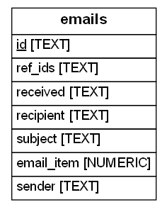
Project Component Breakdown
Three primary modules
Data Collection
Collect Email from imap server and cache to disk using SQLite DB;
imap host
Download and generate unique ID
Sqlite3_email.db
Notes:
Red block:
This preserves imap protocol RFC822 specified “envelope” structure for ease of access should downloader module be extracted and used in a separate project.
Green block:
Exposes header meta-data as a dictionary, and the message body as a string;

Slide 15
Project Component Breakdown
Three primary modules
Parsing imap structure, data cleaning, message formatting
Collect Email from imap server and cache to disk using SQLite DB;
Load email envelopes from disk and construct custom python dataclass objects for each email;
Cache these dataclass objects to disk as a separate SQLite DB
Load message bodies from disk and apply lemmatization/stop-word filtration before producing statistical word count data;
Cache lemma and statistical data to disk in another new SQLite DB.
Notes:
Red block:
This preserves imap protocol RFC822 specified “envelope” structure for ease of access should downloader module be extracted and used in a separate project.
Green block:
Exposes header meta-data as a dictionary, and the message body as a string;

Slide 16
Project Component Breakdown
Three primary modules
Parsing imap structure, data cleaning, message formatting
Collect Email from imap server and cache to disk using SQLite DB;
Load email envelopes from disk and construct custom python dataclass objects for each email;
Cache these dataclass objects to disk as a separate SQLite DB
Load message bodies from disk and apply lemmatization/stop-word filtration before producing statistical word count data;
Cache lemma and statistical data to disk in another new SQLite DB.
Sqlite3_email.db
Load imap envelope to memory
Separate header-meta-data from message string
Sqlite3_body.db
Notes:
Red block:
This preserves imap protocol RFC822 specified “envelope” structure for ease of access should downloader module be extracted and used in a separate project.
Green block:
Exposes header meta-data as a dictionary, and the message body as a string;

Slide 17
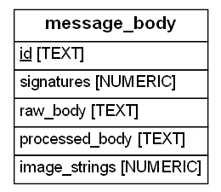
Project Component Breakdown
Three primary modules
Parsing imap structure, data cleaning, message formatting
Collect Email from imap server and cache to disk using SQLite DB;
Load email envelopes from disk and construct custom python dataclass objects for each email;
Cache these dataclass objects to disk as a separate SQLite DB
Load message bodies from disk and apply lemmatization/stop-word filtration before producing statistical word count data;
Cache lemma and statistical data to disk in another new SQLite DB.
Sqlite3_email.db
Load imap envelope to memory
Separate header-meta-data from message string
Sqlite3_body.db
Notes:
Red block:
This preserves imap protocol RFC822 specified “envelope” structure for ease of access should downloader module be extracted and used in a separate project.
Green block:
Exposes header meta-data as a dictionary, and the message body as a string;

Slide 18
Project Component Breakdown
Three primary modules
Message lemmatization, statistical pre-processing
Collect Email from imap server and cache to disk using SQLite DB;
Load email envelopes from disk and construct custom python dataclass objects for each email;
Cache these dataclass objects to disk as a separate SQLite DB
Load message bodies from disk and apply lemmatization/stop-word filtration before producing statistical word count data;
Cache lemma and statistical data to disk in another new SQLite DB.
Notes:
Red block:
This preserves imap protocol RFC822 specified “envelope” structure for ease of access should downloader module be extracted and used in a separate project.
Green block:
Exposes header meta-data as a dictionary, and the message body as a string;
Blue block:
…

Slide 19
Project Component Breakdown
Three primary modules
Message lemmatization, statistical pre-processing
Collect Email from imap server and cache to disk using SQLite DB;
Load email envelopes from disk and construct custom python dataclass objects for each email;
Cache these dataclass objects to disk as a separate SQLite DB
Load message bodies from disk and apply lemmatization/stop-word filtration before producing statistical word count data;
Cache lemma and statistical data to disk in another new SQLite DB.
Sqlite3_body.db
Load message string to memory
Apply lemmatization
Build NLTK.WordBag
Remove stop-words
Sqlite3_lemma.db
Notes:
Red block:
This preserves imap protocol RFC822 specified “envelope” structure for ease of access should downloader module be extracted and used in a separate project.
Green block:
Exposes header meta-data as a dictionary, and the message body as a string;
Blue block:
…

Slide 20
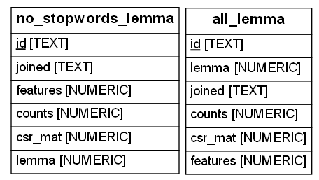
Project Component Breakdown
Three primary modules
Message lemmatization, statistical pre-processing
Collect Email from imap server and cache to disk using SQLite DB;
Load email envelopes from disk and construct custom python dataclass objects for each email;
Cache these dataclass objects to disk as a separate SQLite DB
Load message bodies from disk and apply lemmatization/stop-word filtration before producing statistical word count data;
Cache lemma and statistical data to disk in another new SQLite DB.
Sqlite3_body.db
Load message string to memory
Apply lemmatization
Build NLTK.WordBag
Remove stop-words
Sqlite3_lemma.db
Notes:
Red block:
This preserves imap protocol RFC822 specified “envelope” structure for ease of access should downloader module be extracted and used in a separate project.
Green block:
Exposes header meta-data as a dictionary, and the message body as a string;
Blue block:
…

Slide 21
Results
A sample of what an open source tool aimed towards customization can allow.
Notes:
Luke’s “code scribbles” produced these figures
Data science is an interdisciplinary field that uses scientific methods, processes, algorithms and systems to extract knowledge and insights from structured and unstructured data
Things to add to slide:
since stakeholder is a statistical chemist, he does research on data clustering
So, we are essentially, trying to expose data available in one’s own inbox so that he, and people like him, can apply those analytic skills to that data.
Say that it’s in R
We can now say we classified emails as well.
Paper shared pertains to genetics “micro-expressions” data – look up what micro-expressions are.

Slide 22
Results: Project generated DB schema
Notes:
Things to add to slide:
Say that it’s in R
We can now say we classified emails as well.

Slide 23
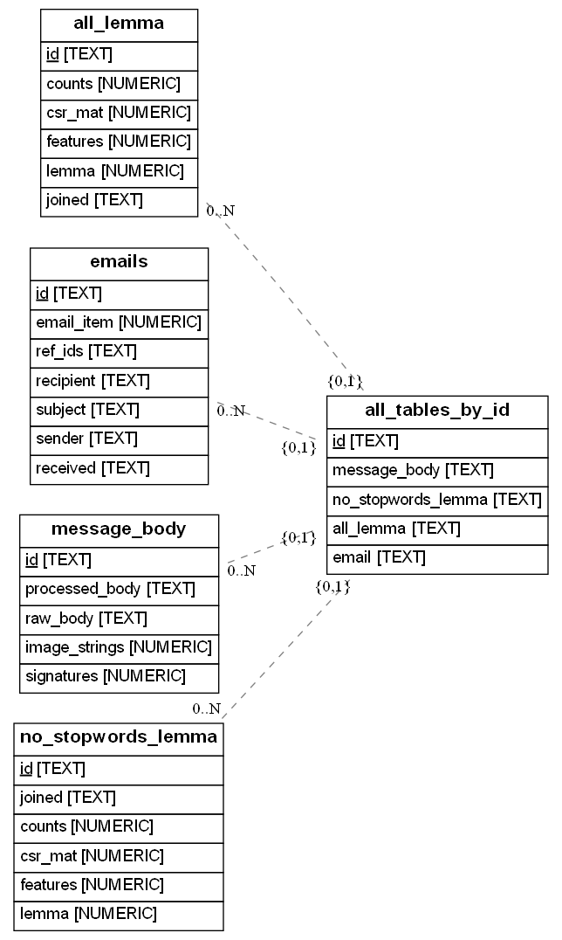
Results: Project generated DB schema
An example of the programmatically generated DB ERD for a contrived DB composed from the 3 descrete databases shown in the previous slide.
Notes:
Things to add to slide:
Say that it’s in R
We can now say we classified emails as well.

Slide 24
Conclusion: In its Current State
In this project we built:
4 modules:
Email collection from an imap host inbox.
Conversion from imap envelope structure into header-meta-data and the message string.
Basic statistical and structural generation from message strings.
Lemmatization
Stop-word filtering
Word-counts
Utility tools and functions used by all three of the preceding modules.
Custom logging tools for detailed and visually clear diagnostic output
Notes:
This should be a bulleted list of what was done, what the next steps look like,
(maybe interesting points along the way)
and finally, a thank you!
Thank Prof. Erdly, Dr. Marney, the UWB CSS dept, Kiera, and anyone else
that conceivably contributed.

Slide 25
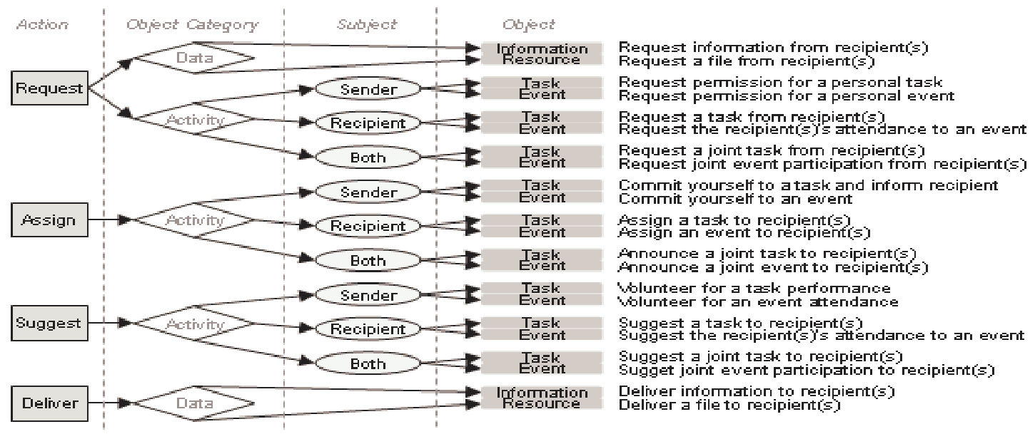
Conclusion: Next Steps
Improve structural analysis toolset
Specifically, implement the Speech-Act-Theory strategy described in Classifying Action Items for Semantic Email. See figure to the right:
Update CLI to use curl and possibly blast
Notes:
This should be a bulleted list of what was done, what the next steps look like,
(maybe interesting points along the way)
and finally, a thank you!
Thank Prof. Erdly, Dr. Marney, the UWB CSS dept, Kiera, and anyone else
that conceivably contributed.

Slide 26
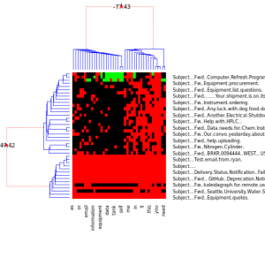
Conclusion: Future research possibilities
Data science is an interdisciplinary field that uses scientific methods, processes, algorithms and systems to extract knowledge and insights from structured and unstructured data
Numerical and Categorical Metadata
Emails and Words
Chemometrics, genomic, proteomic,
and metabolomic clustering tools
Meaningful information about physical processes
Future Research Question: Can we use the same tools?
Bayesian Hierarchical clustering (BHC)
Notes:
Luke’s “code scribbles” produced these figures
Data science is an interdisciplinary field that uses scientific methods, processes, algorithms and systems to extract knowledge and insights from structured and unstructured data
Things to add to slide:
since stakeholder is a statistical chemist, he does research on data clustering
So, we are essentially, trying to expose data available in one’s own inbox so that he, and people like him, can apply those analytic skills to that data.
Say that it’s in R
We can now say we classified emails as well.
Paper shared pertains to genetics “micro-expressions” data – look up what micro-expressions are.

Slide 27
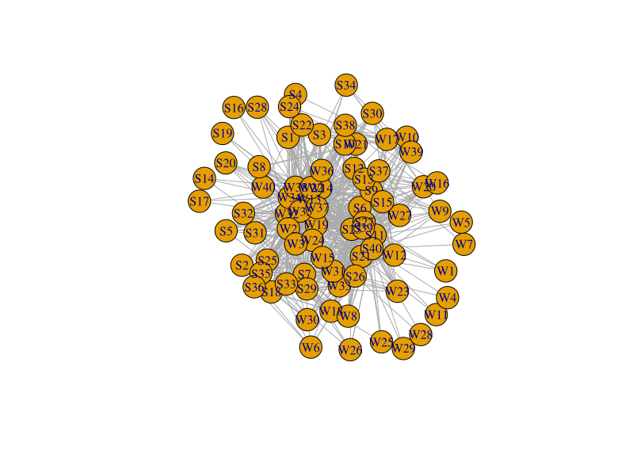
Conclusion: Future research possibilities
Data science is an interdisciplinary field that uses scientific methods, processes, algorithms and systems to extract knowledge and insights from structured and unstructured data
Numerical and Categorical Metadata
Emails and Words
Chemometrics, genomic, proteomic,
and metabolomic clustering tools
Meaningful information about physical processes
Future Research Question: Can we use the same tools?
W = Words ; S = Subject Header
Bayesian Hierarchical clustering (BHC)
Notes:
Luke’s “code scribbles” produced these figures
Data science is an interdisciplinary field that uses scientific methods, processes, algorithms and systems to extract knowledge and insights from structured and unstructured data
used a simple Kamada Kawai spring energy minimum layout (a default option with igraph package in R) and the weights of the edges are defined by the counts of a word appearing in the respective emails

Slide 28
Thank you
Huge thanks go out to:
Prof. Bill Erdly for being my faculty advisor on this project.
Dr. Luke Marney for being the project’s sponsor and primary stake holder.
The UWB CSS dept. faculty and staff for providing the education and services that allowed me to be where I am today!
Kiera Peters for being greatest moral supporter throughout my college career as well as this project.
Notes:
This should be a bulleted list of what was done, what the next steps look like,
(maybe interesting points along the way)
and finally, a thank you!
Thank Prof. Erdly, Dr. Marney, the UWB CSS dept, Kiera, and anyone else
that conceivably contributed.

Slide 29






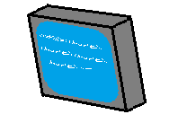








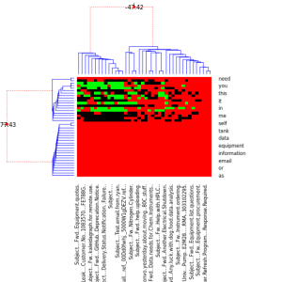




In Brief:
The Acme project is an open-source toolkit for experts in statistics (like Chemists, Astrologers, Geologists, etc.,) to gain access to the treasure trove of information hidden in their own inbox.
We aim to empower everyone, regardless they have a CS background, the capacity to apply statistical inference and machine learning tools to their email inbox. Be it introspective analysis for insight into their own processes, or the development of custom filtration/classification tools to improve their workflow.
A.C.M.E.:
Automated
Collection and
Manipulation of
Email
For most people, handling high email volume is a necessary evil, it’s just part of getting the job done.
But, for many of us, our passions and strengths don’t include organizing an inbox…
It’s time to call A.C.M.E.!
On average, professionals have more than 200 emails in their inbox and receive 120 new ones each day but respond to only 25% of them.
- https://hbr.org/2019/01/how-to-spend-way-less-time-on-email-every-day
Automated email classification and categorization is a long-standing issue, where most existing solutions are closely guarded behind IP patents or buried in archaic technical obscurity (we’re looking at you imap protocol RFC822.
But with A.C.M.E., you can build the tools you need more easily than ever! So put on your mining cap, because it’s time to unlock data potential of your inbox! If exploring new data, or finding new correlations in the world is your thing, you’re going to love digging into your inbox!
Preliminary analysis and future steps
Some of the project’s currently active undertakings.
A sample of the project’s next steps
A backlogged module for this project’s future is to explore the development an Agent/Patient/Object structured module. Built according to publications on the Speech-Act-Theory.
A truncated table showing an abstracted component structure can be seen bellow.
Python
Exploring the impact of including “stop-words” in word frequency analysis.
Taken from a conference paper published in 2010,
titled: “Classifying Action Items for Semantic Email”
By: Scerri, Simon & Gossen, Gerhard & Davis, Brian & Handschuh, Siegfried

Slide 30
Citations
Soya Park, Amy X. Zhang, Luke S. Murray, and David R. Karger. 2019.
Opportunities for Automating Email Processing: A Need-Finding Study.
Proceedings of the 2019 CHI Conference on Human Factors in Computing Systems.
Association for Computing Machinery, New York, NY, USA, Paper 374, 1–12.
DOI: https://doi.org/10.1145/3290605.3300604
Bahareh Sarrafzadeh, Ahmed Hassan Awadallah, Christopher H. Lin, Chia-Jung Lee, Milad Shokouhi, and Susan T. Dumais. 2019.
Characterizing and Predicting Email Deferral Behavior.
Proceedings of the Twelfth ACM International Conference on Web Search and Data Mining WSDM ‘19.
Association for Computing Machinery, New York, NY, USA, 627–635.
DOI: https://doi.org/10.1145/3289600.3291028
Scerri, Simon & Gossen, Gerhard & Davis, Brian & Handschuh, Siegfried.
2010.
Classifying Action Items for Semantic Email.
Retrieved from https://www.researchgate.net/publication/220746717_Classifying_Action_Items_for_Semantic_Email
Retrieved on March 20, 2021

Slide 31
Full link addresses
NLTK: Natural Language Toolkit for Python https://www.nltk.org/
SQLite https://www.sqlite.org/index.html
Doit https://pydoit.org/
Pandas https://pandas.pydata.org/
Numpy https://numpy.org/doc/stable/user/whatisnumpy.html
Numba https://numba.pydata.org
cURL https://curl.se/
Blast https://github.com/mosuka/blast

Slide 32
Existing TOOLs sharing our objectives
Melusine: An open source tool for performing automated classification of email messages.
https://github.com/MAIF/melusine/blob/master/melusine/models/attention_model.py
Notes:
We are working towards building a tool that lets a user get into the nuts and bolts of the automation, not an end product that just does it all for them.

Slide 33
Email Classification
Bayesian Hierarchical clustering (BHC)
Notes:
Things to add to slide:
Say that it’s in R
We can now say we classified emails as well.

Slide 34
What ARE Tasks
“doit is all about automating task dependency management and execution.
Tasks can execute external shell commands/scripts or python functions (actually any callable).
So, a task can be anything you can code :)”
From: https://pydoit.org/tasks.html

Slide 35
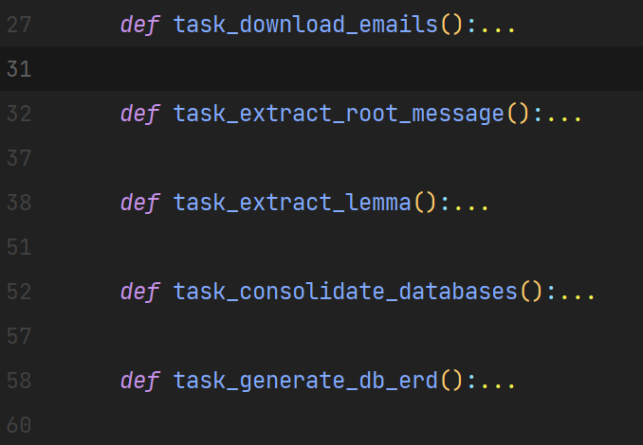
Tasks defined in this project:
<- Primary module
<- Primary module
<- Primary module
<- Utility task specific to this project
<- Utility task specific to this project

